Slide 1

Python
Programming with Python Handling File (read & write)

Slide 2

File Processing
• A text file can be thought of as a sequence of lines
• We will learn how to read from a text file.

Slide 3
Opening a File
• Before we can read the contents of the file we must tell Python which file we are going to work with and what we will be doing with the file
• This is done with the open() function
• open() returns a “file handle” - a variable used to perform operations on the file
• Kind of like “File -> Open” in a Word Processor

Slide 4
Using open()
handle = open(filename, mode)
e.g
fhand = open('mbox.txt', 'r')
• returns a handle use to manipulate the file
• filename is a string
• mode is optional and should be 'r' if we are planning reading the file and 'w' if we are going to write to the file.

Slide 5
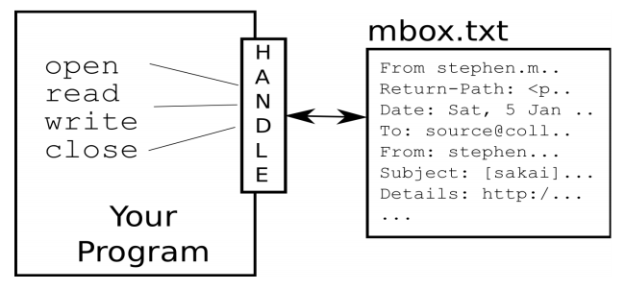
What is a Handler Object?
• >>> fileHandler = open('mbox.txt')
• >>> print(fileHandler)
• <open file 'mbox.txt', mode 'r' at 0x1005088b0>

Slide 6
Reading lines from file
To use methods on file object:
readline()
readlines()
Iterate through each line by using for loop

Slide 7
Counting lines in a File
• Open a file read-only
• Use a for loop to read each line
• Count the lines and print out the number of lines

Slide 8
Searching Through a File
We can put an if statement in our for loop to only print lines that meet some criteria
fhand = open('mbox-short.txt')
for line in fhand:
if line.startswith('From:') :
print line

Slide 9
THANK YOU
www.skillslash.com

